Slide 1

SkillsetAI
AI-based personalized learning platform
Team name: Code Champs
Team members:
Jaideep Amrabad
Bhanu Prasad
Ganesh Goud
Hackathon name: AI Hackdays

Slide 2
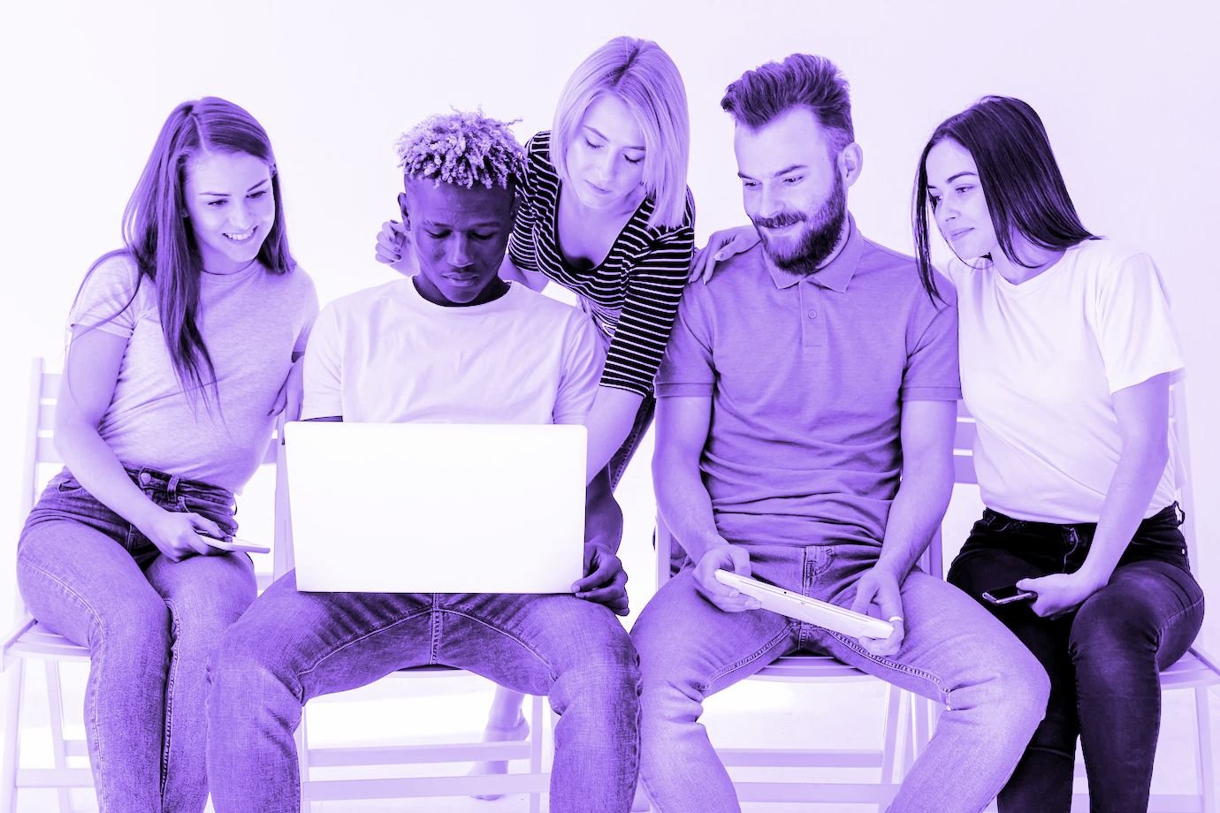
Introduction
👋 Welcome to Skillset AI — an AI-powered learning platform that makes skill-building fun, affordable, and effective.
What We Do:
Help students and professionals learn new skills.
Use AI to recommend personalized learning paths.
Keep users engaged with games, quizzes, and rewards.

Slide 3
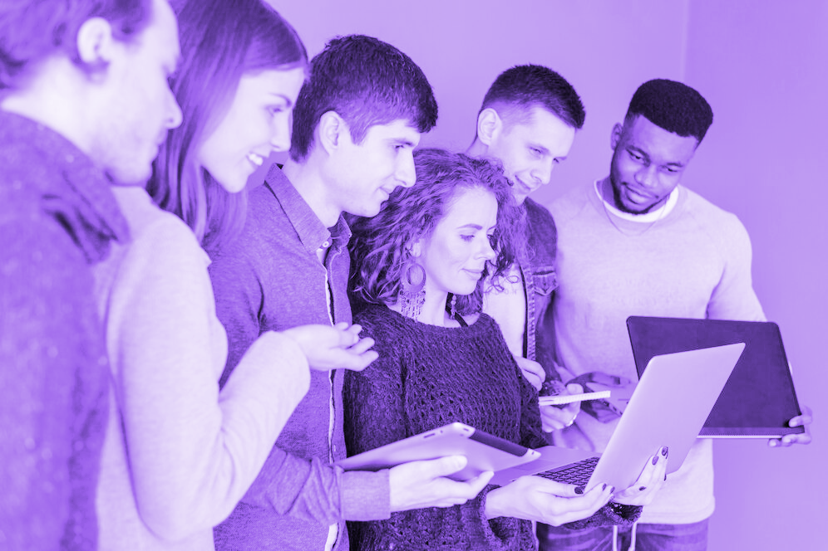
Problem statement
Why Skillset AI? 🤔 The world is changing, but learning hasn’t caught up.
Traditional platforms: Too boring, too expensive.
Students’ struggles:
Lack of motivation.
Too many options, no clear direction.
Learning alone feels isolating.

Slide 4
Innovation and Creativity ✨ Skillset AI combines the power of technology with human-friendly learning.
What Makes Skillset AI Innovative?
Affordable & Collaborative Growth
Combines AI-powered personalization with gamified learning for a unique user experience.
Focus on community-driven growth through peer interactions and collaborative learning.
Gamified rewards motivate consistent learning.
Interactive quizzes and games transform traditional learning methods into fun activities.

Slide 5
Technical Implementation Overview
React.js
Node.js
MongoDB
Python
Firebase
Bootstrap

Slide 6
Feasibility and Real-World Application
Feasibility: ✅ Affordable technologies enable cost-effective scaling. 🛠️ Modular architecture allows future enhancements.
Real-World Application: 🏫 Educational Institutions: Enhance traditional teaching methods. 🧑‍🎨 Freelancers & Hobbyists: Learn on-demand skills and grow portfolios.

Slide 7
Benefits
Personalized Learning
AI Tutors
Gamified Learning
Community Support

Slide 8
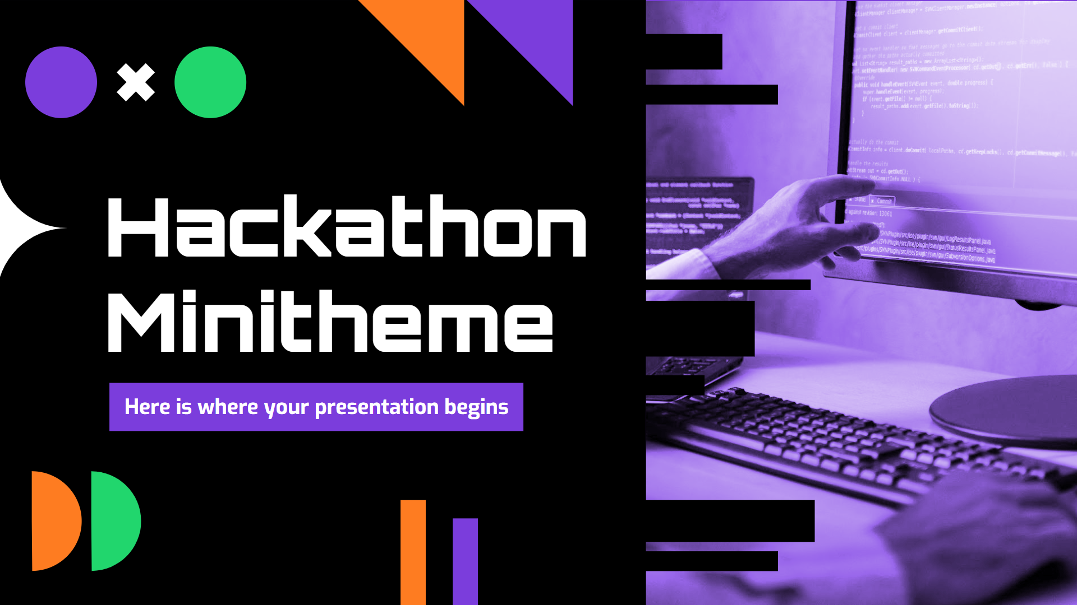
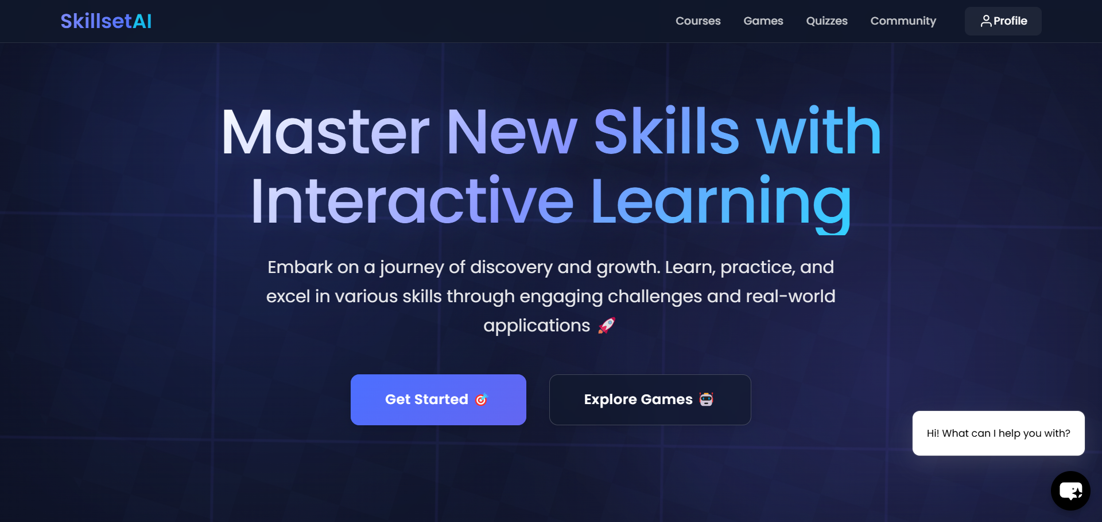
Project Demo
Click the image beside to visit our website and explore more!

Slide 9
Future Work and Improvements
Planned Enhancements: 🌟 AR/VR Integration: Immersive learning experiences. 🤖 AI Mentorship: Virtual tutors for personalized guidance. 🏆 Dynamic Leaderboards: Foster healthy competition.
Long-Term Vision: 🌐 Connect with job boards for real-world opportunities. 🤝 Expand global collaboration in the community. 📱 Launch mobile apps for broader accessibility.

Slide 10

Conclusion
Skillset AI: Transforming Learning, One Skill at a Time 🎯 Our mission is simple: Make learning engaging, personalized, and accessible for everyone.
What We Achieve Together: ✔️ Empower students with AI-driven learning paths. ✔️ Foster a global learning community. ✔️ Redefine education with fun, affordable solutions.

Slide 11
Thank you!
Let’s Make Learning Fun!

